Slide 1

KKR & KSR INSTITUTE OF TECHNOLOGY AND SCIENCES
(Autonomous)
(Approved by A.I.C.T.E New Delhi || Permanently Affiliated to JNTUK, Kakinada) ||
Accredited with ‘A’ Grade by NAAC )
DEPARTMENT OF COMPUTER SCIENCE AND ENGINEERING
A Hybrid Analytical Framework for Bitcoin Transaction Network Forensic Investigation
Presented By
LAKKARAJU SRIRAM PRASAD(23JR5A0515)
KOVURI VENKATA MANESH(22JR1A05B2)
MANIKESWARAM ABDUL RAHIM(22JR1A05B7)
MANNAVA AKASH(22JR1A05B8)
Under the Guidance of
Mr. M. HANUMANTHA RAO
Assistant Professor,
Department of CSE

Slide 2
INDEX
ABSTRACT
INTRODUCTION
LITERATURE REVIEW
PROBLEM DEFINITION
EXISTING SYSTEM
PROPOSED SYSTEM
DESIGN PHASE

Slide 3
ABSTRACT
The increasing use of Bitcoin has created significant challenges for digital forensic investigations due to its pseudo-anonymous nature. Although all Bitcoin transactions are publicly recorded on the blockchain, identifying suspicious activities within large and complex transaction networks remains difficult. Existing forensic approaches often rely on isolated techniques such as basic transaction tracing or standalone machine learning models, which are insufficient for accurate investigation. This paper proposes a hybrid analytical framework that models Bitcoin transactions as a directed network graph to extract meaningful structural features. These graph-based features are combined with transaction behavior attributes to form a unified forensic feature set. A Random Forest classification algorithm is applied to analyze the used features and classify wallet addresses as normal or suspicious. Experimental results on public Bitcoin datasets demonstrate that the proposed approach improves forensic accuracy and scalability.

Slide 4
INTRODUCTION
Bitcoin is a decentralized digital currency that enables peer-to-peer transactions without the involvement of intermediaries.
Bitcoin provides pseudo-anonymity by using wallet addresses instead of real user identities.
This feature has also enabled its misuse for illegal activities such as fraud and money laundering.
All Bitcoin transactions are permanently recorded on a public blockchain and are accessible for analysis.
However, the large volume and complex structure of transaction networks make forensic investigation difficult.
Existing forensic approaches rely on isolated techniques such as transaction tracing or standalone machine learning models.
This project proposes a hybrid analytical framework that combines graph-based network analysis with machine learning techniques.

Slide 5
LITERATURE REVIEW
Sl. No | Authors / Year | Type of Input | Approach | Advantages | Disadvantages
1 | Asiri et al., 2025 | Bitcoin transaction graph | Graph-based deep learning (GCN) | High detection accuracy | Computationally expensive
2 | Reddy et al., 2025 | Bitcoin transaction records | Pattern-based forensic analysis | Easy to analyze flows | Limited prediction capability
3 | Pérez-Cano et al., 2025 | Transaction & network features | Machine learning with graph features | Works on large datasets | Model complexity
4 | Atlam et al., 2024 | Blockchain forensic datasets | Survey of forensic frameworks | Clear research gaps | No implementation
5 | Vlahavas et al., 2024 | Bitcoin transaction data | Unsupervised clustering analysis | No labeled data required | Hard to label results

Slide 6
PROBLEM DEFINITION
Bitcoin transactions are recorded publicly on the blockchain, but user identities are hidden behind wallet addresses, making direct identification difficult. This pseudo-anonymity creates challenges for forensic investigators while tracing illegal activities.
The Bitcoin transaction network consists of a very large number of wallets and transactions connected in complex patterns.
Criminal activities such as fraud, money laundering, and ransomware payments exploit Bitcoin’s decentralized nature.
Existing forensic tools often use isolated techniques like rule-based analysis, graph visualization, or standalone machine learning.
There is a lack of a unified and scalable forensic framework that integrates network analysis with intelligent analytical methods.

Slide 7
EXISTING SYSTEM:
Bitcoin transaction data is collected from the public blockchain using basic tools, limited to wallet addresses, transaction amounts, and timestamps without any advanced filtering.
The collected data is converted into a simple transaction network, where wallet addresses are treated as nodes and transactions are treated as links between them.
Basic graph visualization is applied to display wallet connections and suspicious nodes are identified manually through visual inspection of the network.
Transaction features such as transaction count, total sent value, and address activity frequency are extracted individually without combining any network-level structural information.

Slide 8
A standalone machine learning model or a fixed rule-based technique is applied alone to analyze the extracted features and detect suspicious transaction patterns.
The identified suspicious wallets or transactions are reported to forensic investigators for further manual analysis and decision making.
DEMERITS OF EXISTING SYSTEM:
Existing methods rely heavily on a single analysis technique, which limits accuracy when dealing with complex and large-scale Bitcoin transaction networks.
Many suspicious activities remain undetected because traditional models fail to adapt to evolving money-laundering and fraud patterns used by criminals.

Slide 9
PROPOSED SYSTEM
Bitcoin transaction data is collected from the public blockchain in real-time and historical formats to ensure complete coverage. This allows the system to analyze both past transactions and ongoing activities effectively.
The collected data is transformed into a graph-based transaction network for structured analysis. In this network, wallet addresses are treated as nodes and transactions are treated as edges.
Graph analytics techniques are applied to examine wallet connectivity and transaction flow patterns. This helps in identifying suspicious clusters and highly connected wallet addresses.
Statistical analysis is used to evaluate transaction values, frequency, and distribution patterns. Abnormal deviations from normal transaction behavior are flagged for investigation.

Slide 10
Machine learning algorithms are employed to classify transactions and wallet behaviors as normal or suspicious. These models detect complex and hidden fraud patterns that traditional methods cannot identify.
Temporal analysis studies transaction timing and sequence patterns across the network. This helps in detecting coordinated, repeated, or automated suspicious activities.
The hybrid analytical framework integrates graph, statistical, and machine learning outputs. Combining multiple analytical methods improves accuracy and reliability of forensic results.
The system generates detailed forensic reports highlighting suspicious transactions and wallet addresses. These reports support investigators in evidence analysis and legal decision-making.

Slide 11
DESIGN PHASE
The design phase includes the following contents
Design constraints
UML Diagrams
System architecture

Slide 12
DESIGN CONSTRAINTS
Accuracy: The system must achieve high accuracy in detecting illicit Bitcoin wallet addresses and fraudulent transactions to minimize false positives and false negatives.
Speed: The analysis should be performed quickly to support timely forensic investigation and real-time detection of suspicious Bitcoin transactions on the blockchain.
Scalability: The system should be able to scale with increasing volumes of Bitcoin transaction data and growing network sizes as blockchain usage continues to expand.
Data Privacy and Security: Strict measures must be implemented to ensure the integrity and security of forensic data, adhering to regulations for handling digital evidence.
Cost: The cost of implementing and maintaining the system should be reasonable, taking into account expenses related to hardware, software, training, and support.

Slide 13
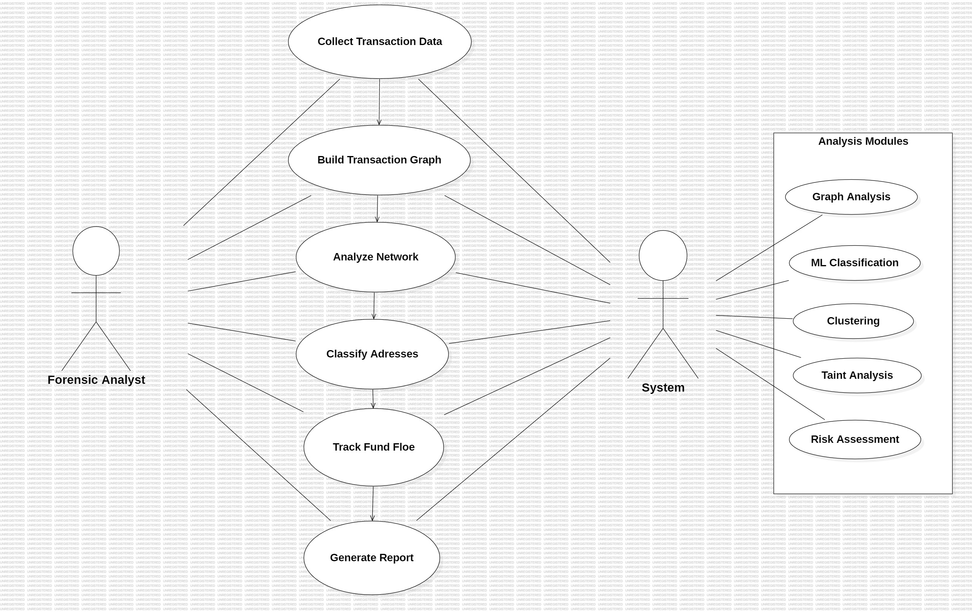
UML DIAGRAMS
USE CASE DIAGRAM:

Slide 14
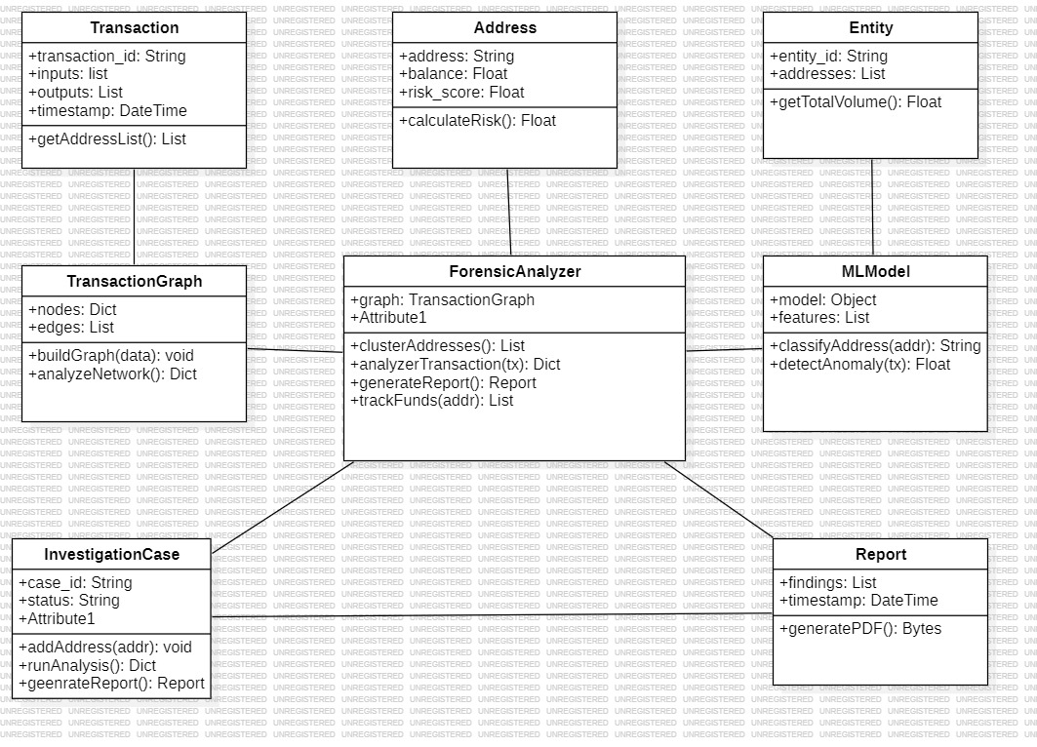
CLASS DIAGRAM:

Slide 15
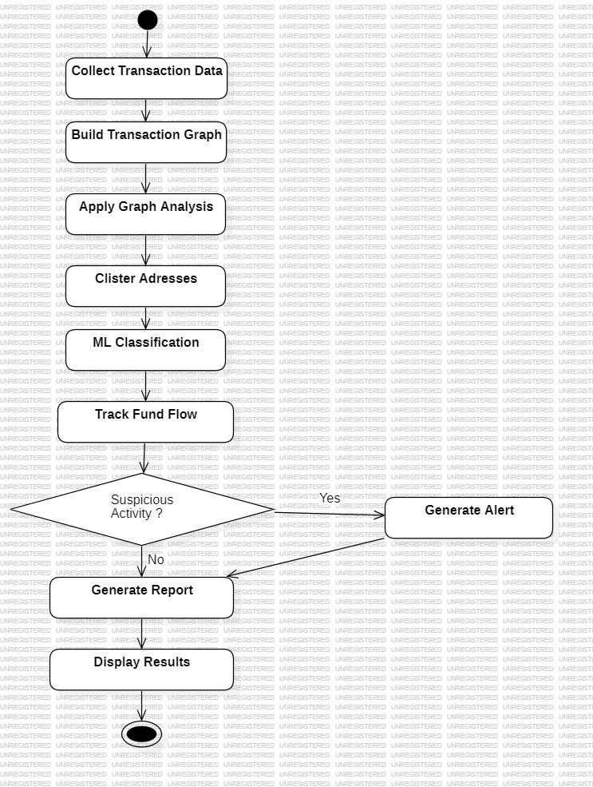
ACTIVITY DIAGRAM:

Slide 16
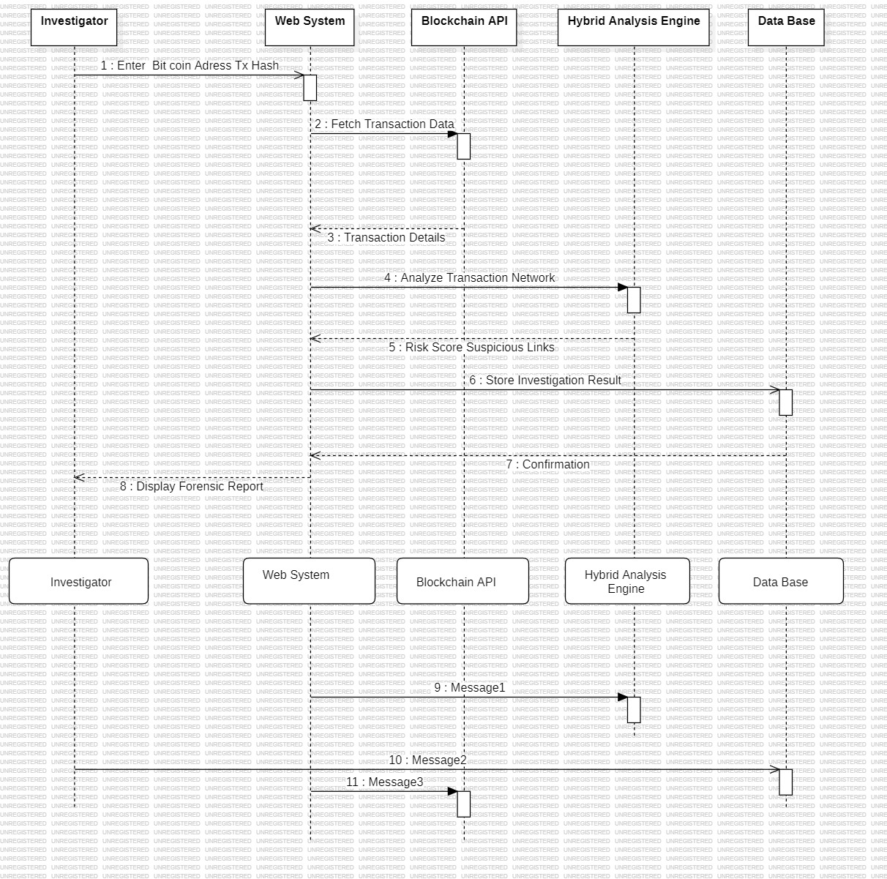
Sequence Diagram

Slide 17
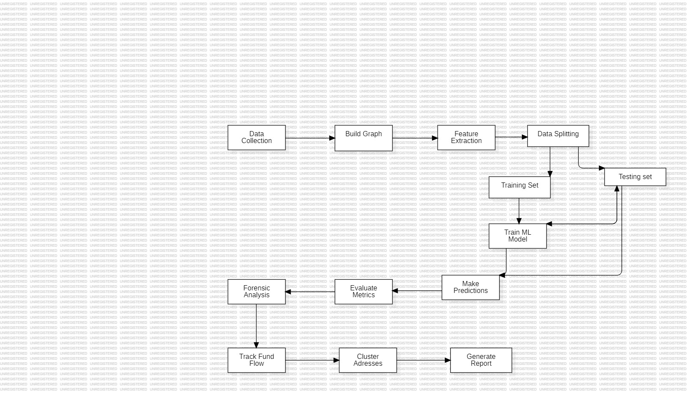
DATA FLOW DIAGRAM:
.

Slide 18
.
Class diagram provide a high-level overview of a system’s design, helping to communicate and document the structure of the software. They are a fundamental tool in object-oriented design and play a crucial role in the software development lifecycle.
Use case diagram at its simplest is a representation of a user's interaction with the system that shows the relationship between the user and the different use cases in which the user is involved. A use case diagram can identify the different types of users of a system
Activity diagram is essentially a fancy flowchart: Activity and state diagrams are related. State chart diagram focuses on s undergoing a process. An activity diagram focuses on the flow of activities involved in a single process. An activity represents the performance of the task or duty in a workflow
Sequence diagram shows object interactions arranged in time sequence. It depicts the objects and classes involved in the scenario and the sequence of messages exchanged between the objects needed to carry out the functionality of the scenario.

Slide 19
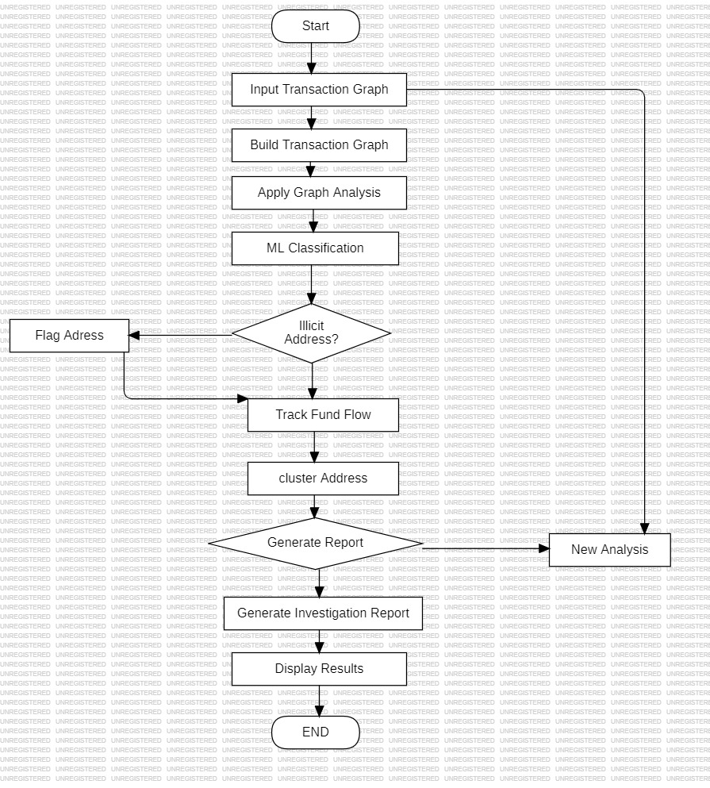
SYSTEM ARCHITECTURE
.

Slide 20
Thank You

